Slide 1

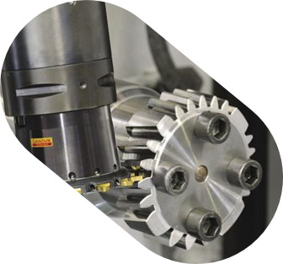
Current status
Project Gear Deburr
- Gijs Winkelhorst
- Sven Kerkhoff

Slide 2
Table of contents
Current 3d model
Overview
How does it work?
Components
test
issues
Future plans

Slide 3
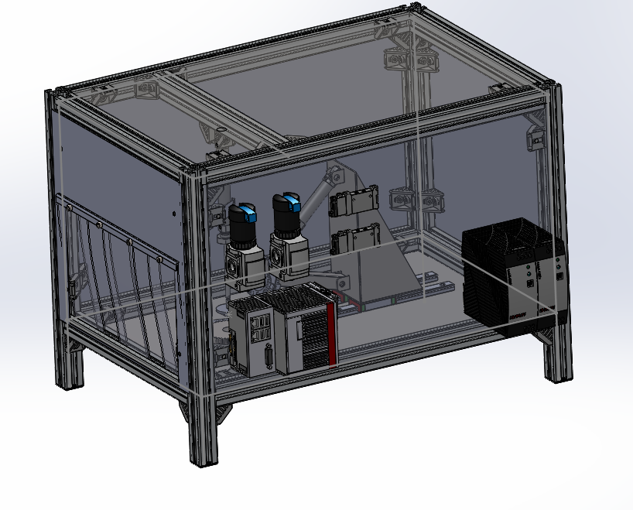
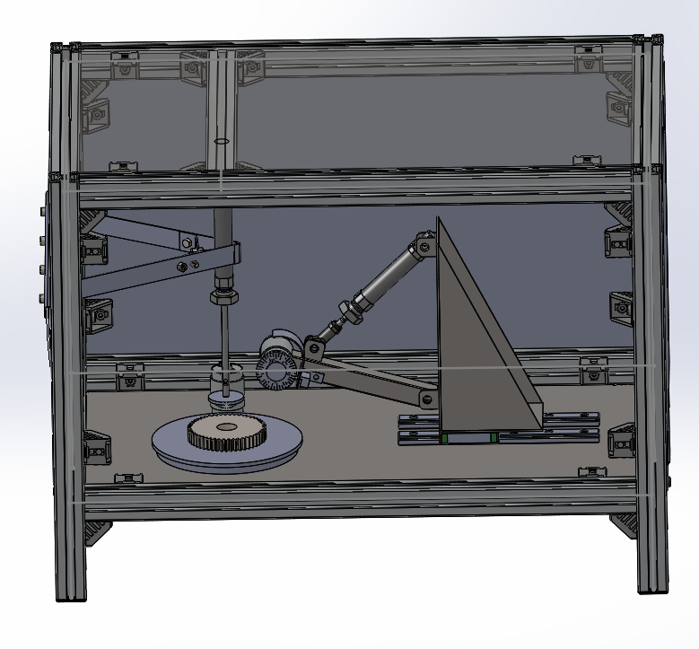
3d model overview
Bosch rexroth frame 30x30 profile
Deburring with a steel brush
Prototype
adjustable to the diameter and height of the gear wheel

Slide 4
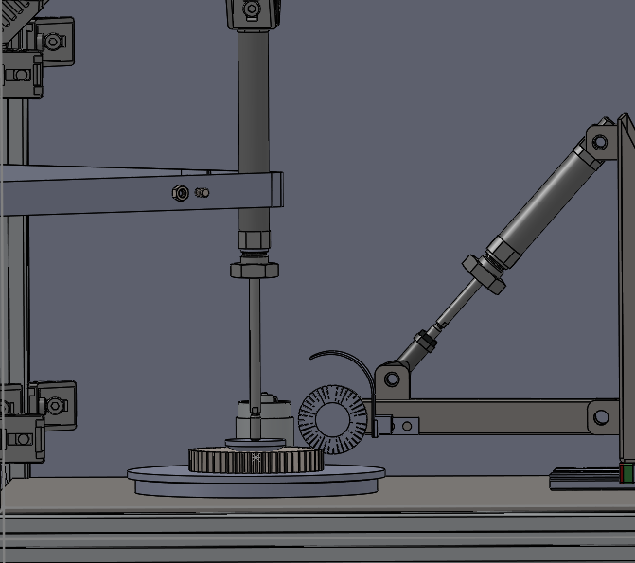
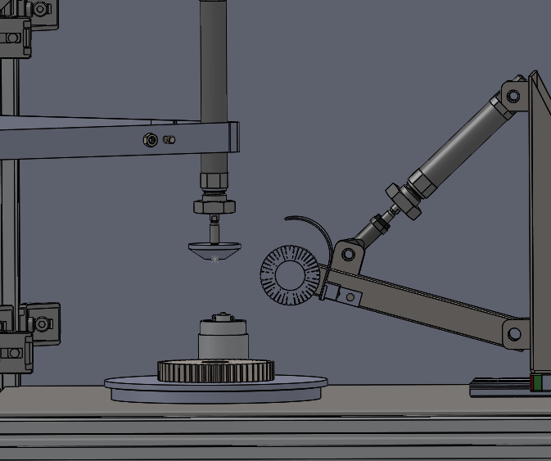
How does it work?
Step 1:
Gear is placed on the turntable by hand or by a robot
Step 2:
Pneumatic cilinder with rotating center presses the gear onto the turntable
Step 3:
steel brush moves to the correct diameter position and is pressed against the gear wheel
Step 4:
Steel brush and turntable starts to rotate. -> gear is getting deburred
Step 5:
Everything returns to its starting position
Step 6:
Gear can be taken out

Slide 5
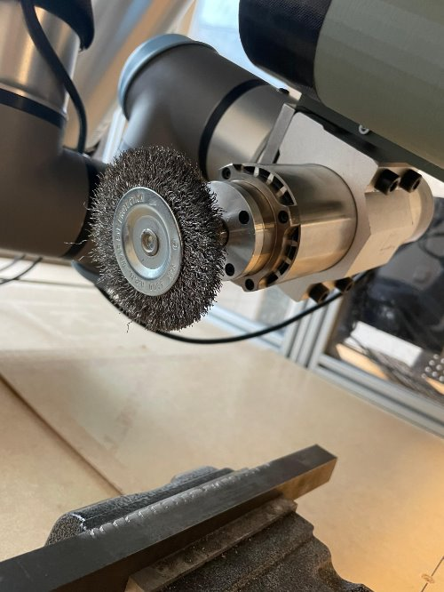
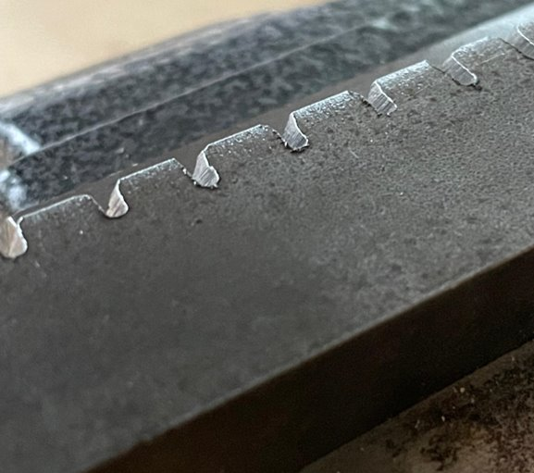
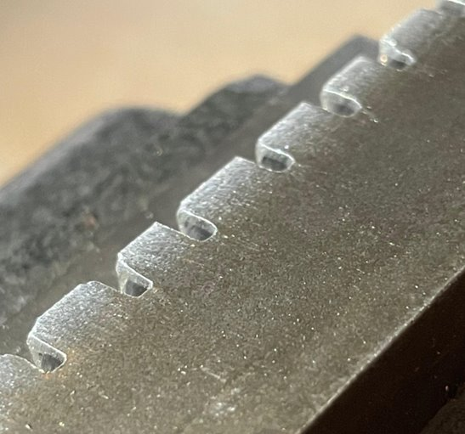
testing
Testing with robot and steel brush
burrs have been removed

Slide 6
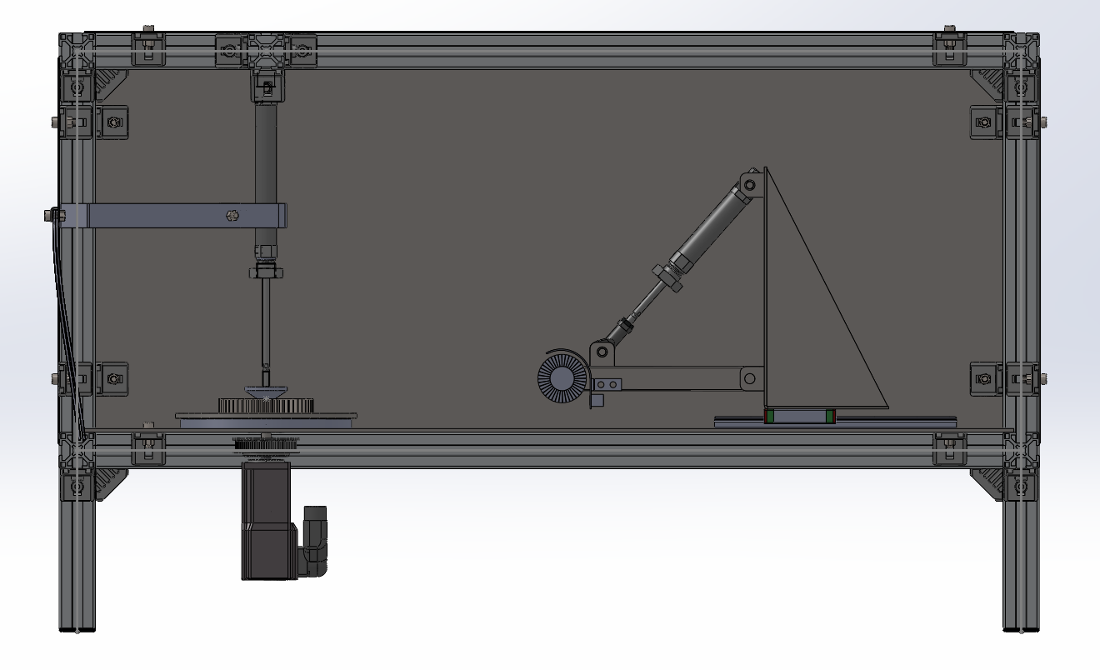
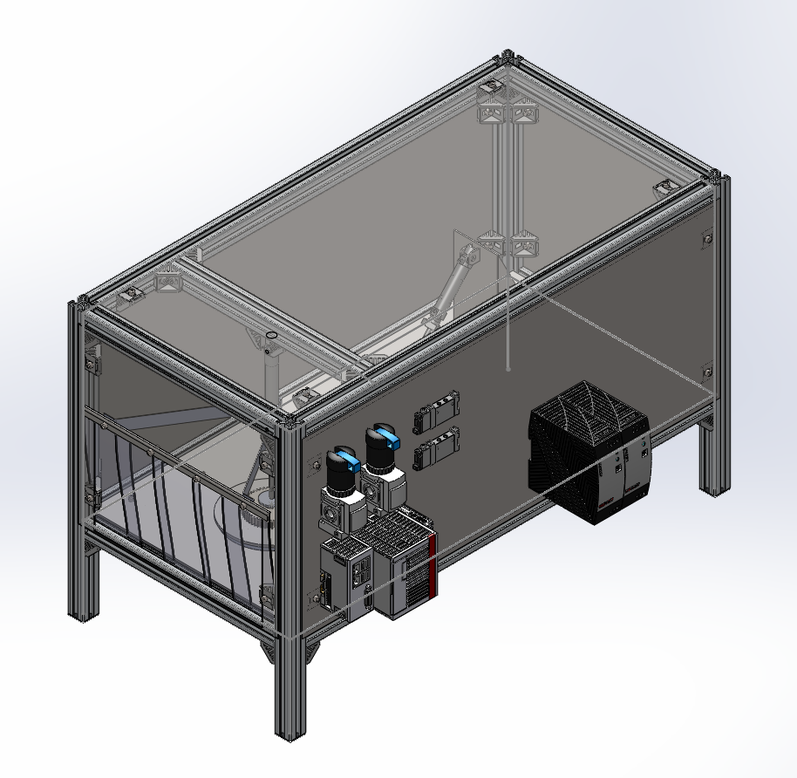
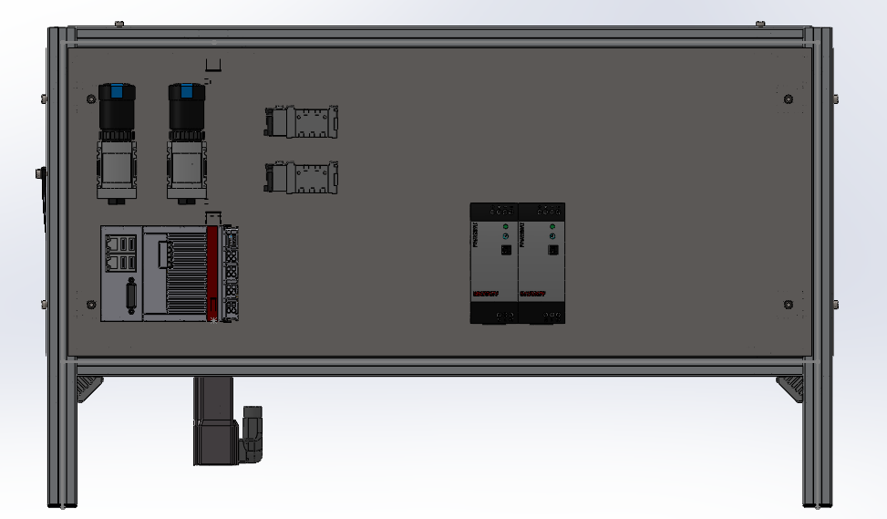
Components

Slide 7
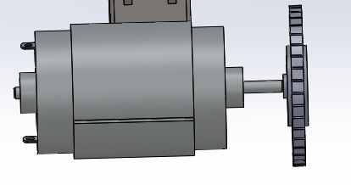
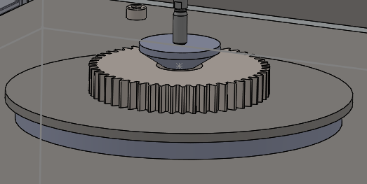
issues
bending force on motor axis.
Bending force supporting gear
Moment of inertia of turntable on motor
Safety features
Dust in machine

Slide 8
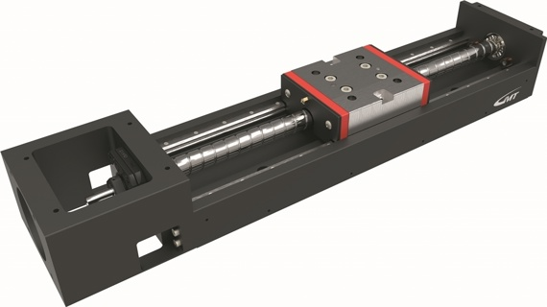
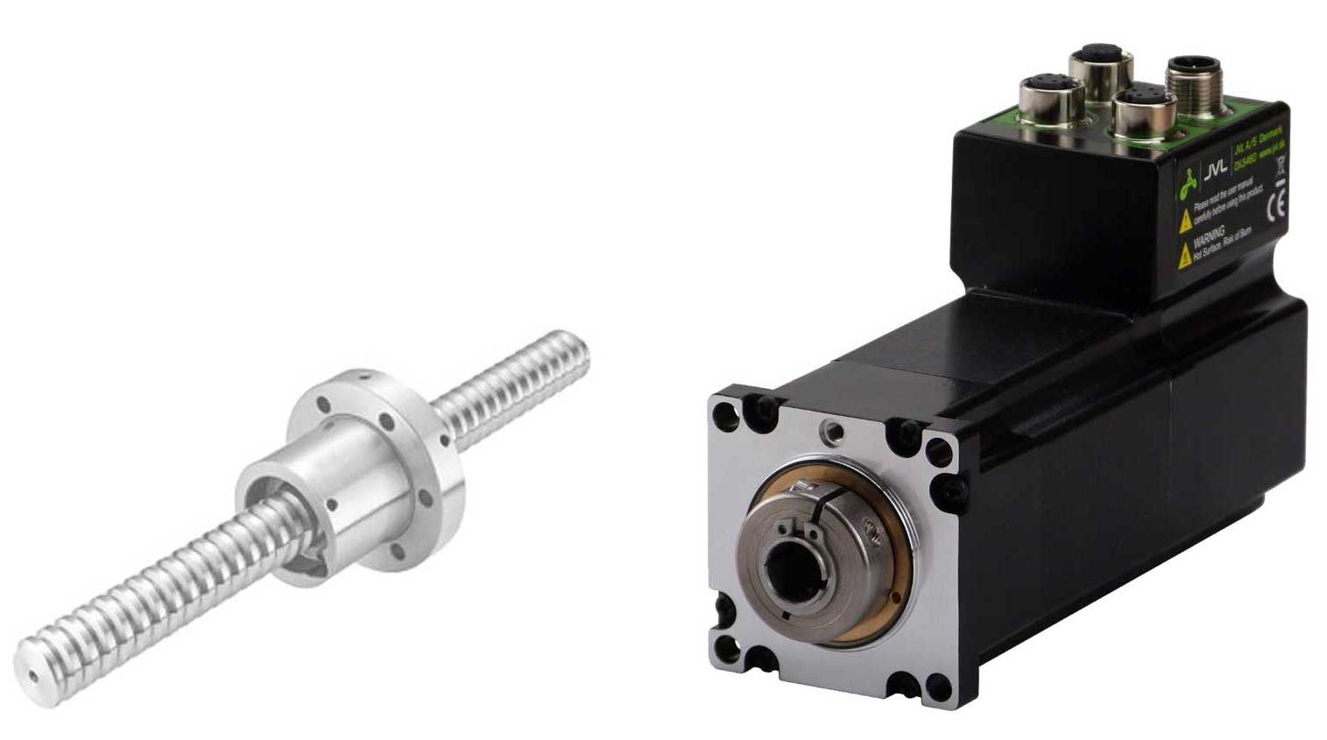
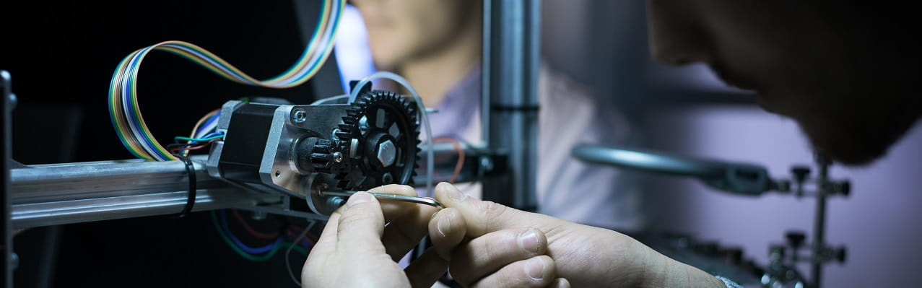
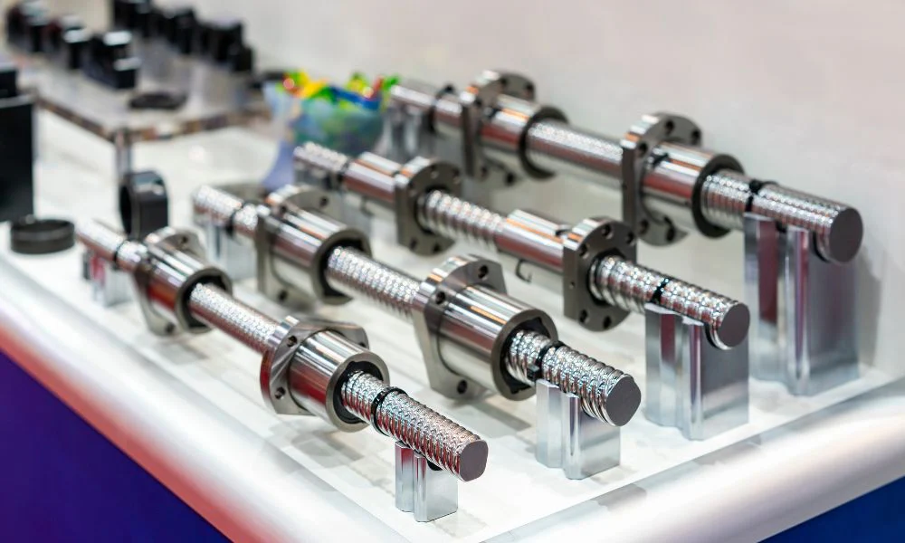
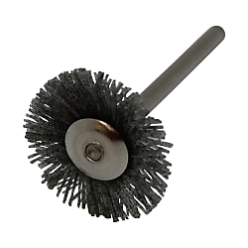
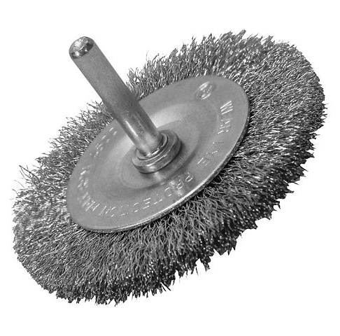
Future plans
Finalize 3d model and components
Wiring
Building the prototype
Programming
testing

